Slide 1

Database Management Systems
Module 1.2: ER Diagram

Slide 2
Agenda
Database Design and ER Modelling
Steps in database Design Process
Concepts and Notations
Relationships and constraints
Examples
Database Management Systems(DBMS)
2

Slide 3
Database Design & ER Diagrams
Requirement Analysis: Collecting information from the users what they want to store in the database.
Conceptual Database Design: High level description of data to be stored in the database. ER model is the ideal one.
Logical Database Design: Selecting an appropriate DBMS for implementation.
Database Management Systems(DBMS)

Slide 4
Database Design & ER Diagrams
Schema Refinement: This is done through normalization theories.
Physical Database Design: Low level implementation like indexing and clustering of tables.
Application and Security Design: Developing a complete application using front-end tools like HTML/CSS, Java, C#.NET, Python/Flask, etc. Unified Modeling Language (UML) may be used.
Database Management Systems(DBMS)

Slide 5
Entities & Entity Sets
Entities
An entity is anything that exists in a real world with an independent existence.
Eg. Maruti Car, Accounts Department , DBMS Book, etc.
Entity Set
Collection of similar entities.
Eg. Employee – Collection of Accounts department employees and HR department employees.
Database Management Systems(DBMS)

Slide 6
Attributes and Keys
Attributes: The properties of an entity can be described by what is known as attributes.
Eg. SSN, Name, Age may be the attributes of the entity set Employees. These attributes are common for all the entities in this entity set.
Attribute Types: Simple or Atomic - hold single value and not composed of any other attributes.
Eg. USN, Age, Date_of_Birth, Dept_No, Sex, etc.
Database Management Systems(DBMS)

Slide 7
Attributes and Keys
Composite: attributes that can be sub-dived into some more attributes are called as composite attributes.
Eg. Address
Single valued: hold only one value for a particular entity.
Eg. Age, Sex
MultiValued: attributes having more than one value.
Eg. DLocation, Qualification - {BE, M Tech, Ph D}
Stored: non-derivable
Eg. Sex, DOB
Derived: can be derived from other attribute(s).
Eg. Age, Total
Database Management Systems(DBMS)

Slide 8
Attributes and Keys
Key: A key is a minimal set of attributes whose values uniquely identify an entity in an entity set. Eg. SSN
Candidate Key: There could be more than one candidate key for each entity set.
Primary Key: One of the candidate keys may be selected as the primary key.
Domain of Attributes: Each attribute is associated with a set of values called as dom(Ai). If the attribute Age takes, say, values between 18 and 58 years, the domain of this attribute is 18-58.
Database Management Systems(DBMS)

Slide 9
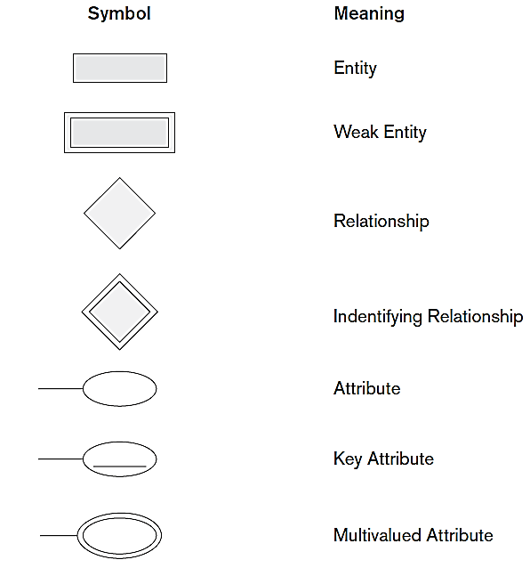
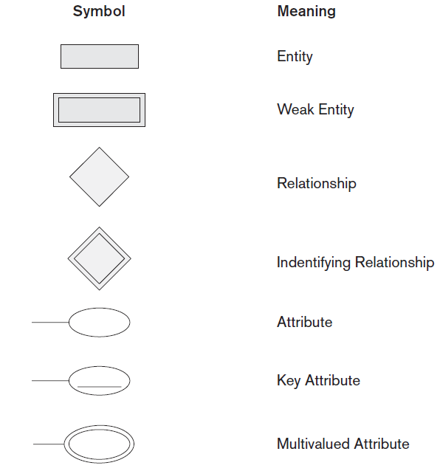
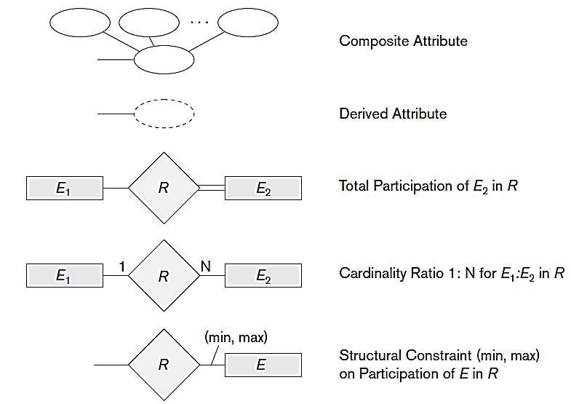
ER Diagram Notations
Database Management Systems(DBMS)

Slide 10
Example – Company DB
Database Management Systems(DBMS)

Slide 11
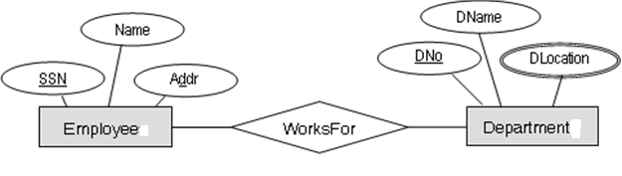
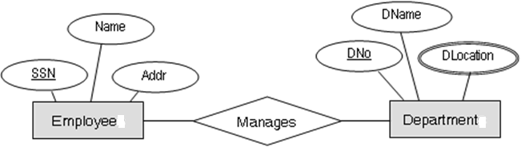
Relationships & Relationship Sets
Relationship - is an association among two or more entities.
Relationship set – is a collection of similar relationships.
Database Management Systems(DBMS)

Slide 12
Instance of Works_For
e₁
e₂
e₃
e₄
r₁
r₂
r₃
r₄
d₁
d₂
d₃
Employee Works_For Department
Database Management Systems(DBMS)

Slide 13
Relationship Degrees
The degree of a relationship type is defined as the number of participating entities.
If the number of participating entities is only two, then it is called as binary relationship.
Suppose if the number of participating entities are three, then it is called as ternary relationship.
Database Management Systems(DBMS)

Slide 14
Example
Ternary Relationship Set
PName
SName
location
Sid
SAddr
PNo
Supply_For
Suppliers
Projects
PtNo
Parts
PtName
Database Management Systems(DBMS)

Slide 15
Instance of Ternary Relationship Set Supply_For
S₁
S₂
S₃
r₁
r₂
r₃
P₁
P₂
P₃
Pt₁
Pt₂
Database Management Systems(DBMS)

Slide 16
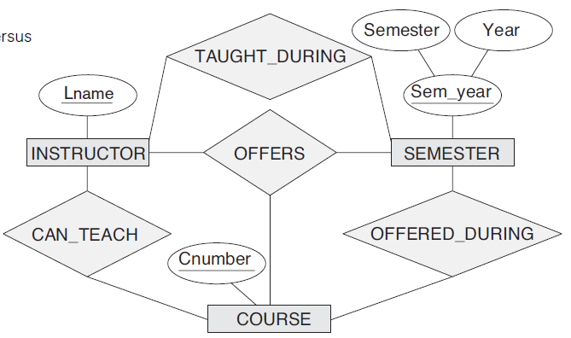
Another Example
Database Management Systems(DBMS)

Slide 17
Constraints on Relationship Types
Cardinality ratio: The cardinality ratio for a binary relationship specifies the number of relationship instances that an entity can participate in.
Example: one-to-one (1:1) means that a Department can have only one Manager.
Types of cardinality mappings:
(a) one-to-one (1:1)
(b) one-to-many (1:N)
(c) many-to-many (M:N)
Database Management Systems(DBMS)

Slide 18
One-to-One cardinality (1:1)
Manages
Employee
Department
Key constraint:
A department can have at most one manager and an employee can manage at most one department.
This restriction can be shown with an arrow in the ER diagram from Departments entity set to Manages relationship and another arrow from Employees entity set to Manages.
Database Management Systems(DBMS)
Notes:
hgfhgfhg

Slide 19
One-to-Many Cardinality (1:M)
M
Works_For
1
Employee
Department
Database Management Systems(DBMS)

Slide 20
Many-to-Many Cardinality (M:N)
M
Register
N
Students
Subjects
M
Works_On
N
Employee
Project
M
Engage
N
Teachers
Subjects
Database Management Systems(DBMS)

Slide 21
Participation Constraints
Total Participation: assume that the company policy is that every department should have a manager. This implies that there will be a full or total participation between Departments and Manages. Therefore, this type of participation is called as total participation (represented as thick or double line).
Manages
Employee
Department
since
Total Participation
Database Management Systems(DBMS)

Slide 22
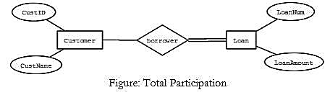
Partial Participation
When an entity set E does not participate fully with a relationship and in turn to the participating entity, such a constraint is called as partial participation.
Manages
Employee
Department
since
Partial Participation
Database Management Systems(DBMS)

Slide 23

Recursive Relationship
When there exists a relationship set which connects the same entity set, then it is called as recursive relationship.
Database Management Systems(DBMS)

Slide 24
Weak Entities
A weak entity set is an entity set such that its key is composed of attributes some or all are of which belong to another entity set.
Weak entity sets do not have their own key attributes (only partial key allowed).
A weak entity will always have total participation with the identifying owner entity.
The owner entity set and the weak entity set must participate in 1:M relationship.
Database Management Systems(DBMS)

Slide 25
Weak Entities - Example
DepName : Partial key
Name
BirthDate
SSN
Addr
DepName
Sex
1
Dependents_Of
M
Employee
Dependent
Database Management Systems(DBMS)

Slide 26
Strong vs. Weak Entity Sets
Strong entity set:
Has sufficient attributes to form a primary key
Weak entity set:
Lacks sufficient attributes to form a primary key
Hence, lacks sufficient attributes to form any key
But every entity set needs a key; What to do?
Must import attributes from strong entity set(s)
A weak entity set member is subordinate to the dominant entity from strong entity set providing attributes to complete its key
Database Management Systems(DBMS)

Slide 27
Example
Database Management Systems(DBMS)

Slide 28
Database Abstractions
An abstraction of some system is a model of that system in which certain details are deliberately omitted.
In some applications a system may have too many details that need to be managed and provide abstraction.
During such instances, it can be managed by decomposing the model into hierarchy of abstractions.
A relation in Codd's relational schema supports two types of abstractions – generalization and aggregation.
Database Management Systems(DBMS)

Slide 29
Generalization
A generalization is an abstraction which enables a class of objects to be thought of generically as a single named object.
We can think of generalization as a relationship between an entity (or class) and one or more refined versions of it.
The generalization is represented through what is known as ISA relationship
Database Management Systems(DBMS)

Slide 30
Example - 1
AccNo
Balance
Account
ISA
SB
FD
RD
CA
Int_amt
Dep_amt
Rec_amt
Od
Database Management Systems(DBMS)

Slide 31
Example-2
Employee
(SSN, Name, Addr, Sex)
Fulltime_Employee
(Days_worked, Salary )
Contract_Employee
( Contract_period, Contract_amount )
Database Management Systems(DBMS)

Slide 32
Aggregation
Aggregation is an abstraction through which relationships are treated as higher-level entities
The ER diagram lacks in establishing a relation between relationships sets.
Using our knowledge of ER diagram, it’s easy to construct the relationship among the three entities Employees, Projects and Machines with Works_on and Uses relationships.
Database Management Systems(DBMS)

Slide 33
Example
Name
Hrs
PNo
PName
SSN
Addr
Works_on
Employee
Project
Uses
To
From
Machine
Mid
OS
Type
OS
Database Management Systems(DBMS)

Slide 34
Aggregation
Why not use a ternary relationship?
Combine Works_On and Uses to a single relationship set? No! Because, each one has its one attribute(s).
Works_On has Hrs and Uses has From and To (dates) attributes.
Hence, the solution is aggregation.
Database Management Systems(DBMS)

Slide 35
ER Diagram with Aggregation
Hrs
Works_On
Employee
Project
Uses
Aggregation
To
From
Machine
Database Management Systems(DBMS)

Slide 36
Example - 2
Aggregation represents a "has-a" or "part-of" relationship between entity sets where one represents the "whole" and the other the "part". Example: each BranchOffice ("whole") has some Staff ("part-of").
Name
BranchID
BranchName
SSN
Addr
Staff
has
BranchOffice
Database Management Systems(DBMS)

Slide 37
Steps to write ER Diagrams
Step-1: Identify the Strong and Weak Entity Sets
Step-2: Identify the ‘relevant’ Attributes
Step-3: Identify the Relationship Sets
Step-4: Identify the Cardinality Ratio and Participation Constraints
Step-5: Identify the IS-A and Has-A Relationship Sets
Step-6: Refine the ER, if required.
Database Management Systems(DBMS)

Slide 38
Case Study
Company DB
Insurance Policy DB
Library System DB
Hotel Management DB
AirPhone DB
Election DB
University, Bank, and Movies DB
Database Management Systems(DBMS)

Slide 39
1. Company DB
Database Management Systems(DBMS)

Slide 40
2. Insurance Policy DB
Database Management Systems(DBMS)

Slide 41
3. Library DB
Database Management Systems(DBMS)

Slide 42
4. Hotel Management DB
Database Management Systems(DBMS)

Slide 43
5. “AirPhone” Database
Assume that you wish to start a small mobile operator company called “AirPhone”. Write an Entity-Relationship diagram to depict the following requirements for your company:
AirPhone has several registered customers with legitimate SIM cards supplied to them categorized into postpaid or prepaid.
The company provides service to its customers in the form of plans depending upon the state and city they are located.
A bill has to be generated for each customer depending upon the billing cycle and usage/plan.
Customers are offered extra services for their family members as a group with special/discounted tariff.
The company has third party outlets in each city to provide customer service. Customers are charged depending upon their usage of voice calls and mobile data or both (combo plan.)
These calls and mobile data consumed by the customers are stored in the database. Also the complaints received from the customers must be registered and resolved within some specified time limit.
Database Management Systems(DBMS)

Slide 44
ER Diagram for
AirPhone DB
name
addr
addr
No_of_SIM
relation
id
Family
Outlet
custid
has
cname
stocks
complid
descr
date
caddr
Complaint
registers
Customer
buys
SIM
date
gets
chooses
SIMNo
n/w
billno
format
amount
Postpaid
details
Bill
Plan
tariff
Prepaid
details
planid
Database Management Systems(DBMS)

Slide 45
6. Election Database
Draw an ER diagram to represent the Election information system based on following description.
In the national elections in India, a state is divided into a number of Constituencies depending upon the population of the state. Several candidates contest elections in each constituency. Each candidate has a unique candidate number. A candidate is allowed to contest in 1 or 2 constituencies at the same time. (For example Prime Minister Narendra Modi had contested from Varanasi & Vadodara). Most candidates belong to a party. Others are independent candidates.
A party is identified by Party name. The party has a date of registration, a symbol (example Hand, Lotus, etc.) and registered address.
The Election information system must record the number of votes obtained by each candidate in each constituency the candidate contested in.
Each state is identified by a unique state name. Each constituency is uniquely identified by a Constituency name. The system must store population of each state & each constituency and capital city of each state.
The Election information system also maintains the voter list. Each voter has a unique Voter id. Other information about the voter that are maintained in the system are Name, date of birth, address, gender and the constituency to which the voter belongs to.
Database Management Systems(DBMS)

Slide 46
ER Diagram for Election DB
Database Management Systems(DBMS)

Slide 47
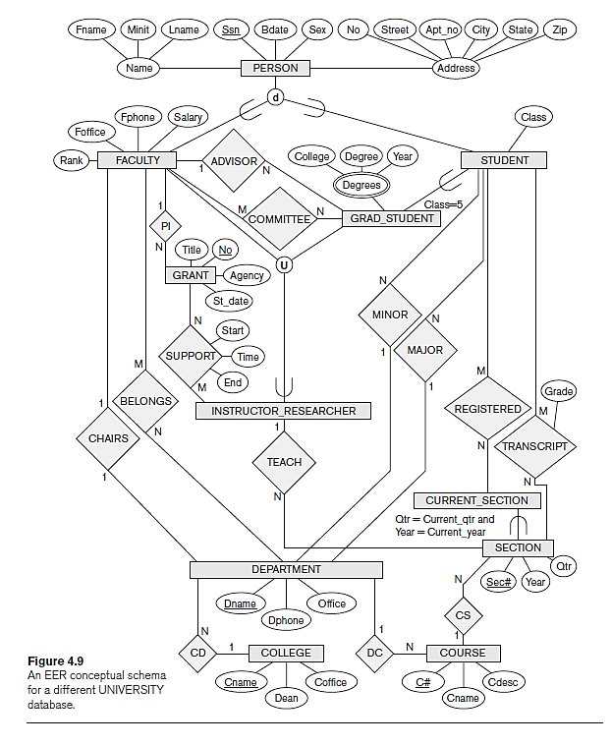
6. UNIVERSITY DB
Database Management Systems(DBMS)

Slide 48
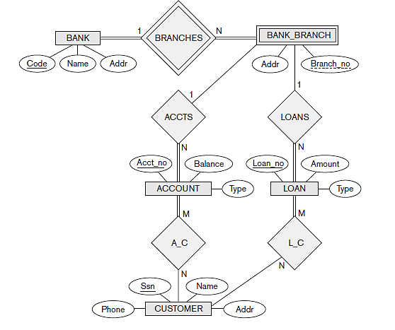
7. BANK DB
Database Management Systems(DBMS)

Slide 49
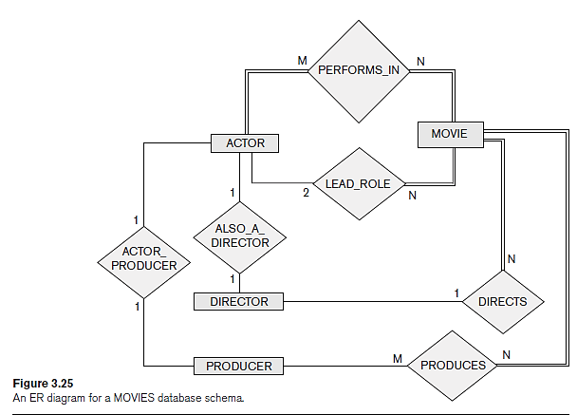
8. MOVIES DB
Database Management Systems(DBMS)

Slide 50
EXERCISES
Database Management Systems(DBMS)

Slide 51
1. Restaurant Database
Write an Entity-Relationship diagram to depict the following requirements for a restaurant:
The restaurant employs a number of chefs. A record is kept of each chef’s name, address, phone number, and salary.
Each chef can prepare a number of meals. The name of the meal and the price of the meal are recorded.
Each meal consists of a number of ingredients. The name of the ingredient and the quantity required for that particular meal is recorded.
These meals are ordered by the customers. A record is kept of the customer’s name, address, and phone number. A record is kept of the time and date the meal is ordered.
State any assumptions made in the design of your E-R diagram.
Database Management Systems(DBMS)

Slide 52
2. Resume Database
Write an Entity-Relationship diagram to depict the following requirements for automating the interview selection process of a company:
The company gets applications/resumes from nay candidates for various posts as per the advertisement.
These candidates are supposed go a number of rounds based on the scheduled fixed by the HR department before they are offered the job. For example, written test, technical interview, HR round, etc.
Their CV, results of each round, and the score, etc., must be recorded in the database.
The candidates are interviewed by a panel of experts. The questions for aptitude test may be selected at random from a pool of questions.
The final selection may be based on the scores and by following some criteria.
State any assumptions made in the design of your E-R diagram.
Database Management Systems(DBMS)

Slide 53
3. Student Database
Write an Entity-Relationship diagram to depict the following requirements for an engineering college considering any specific department:
Each department has number of programmes namely UG, PG, research, etc.
In each programme many students study in various semesters (1 to 8 for UG, 1 to 4 for PG, 4 to 6 years for research).
There are several courses that they need to study depending upon the curriculum. Each course is taught by a faculty. The types of courses include: theory, practical, project, seminar, professional electives, open electives, etc.
We need to record the attendance internal assessment marks, etc. Each student typically take up three internal tests and one university exam.
Every semester is divided into sections. For example, 4th semester may have 4 sections: A, B, C, and D.
Database Management Systems(DBMS)

Slide 54
4. College Database
Design an ER diagram for the following problem:
It is required to store the information regarding Students, Teachers, and Subjects in an Engineering Department of a College or University.
Every student belongs to a particular semester. There are eight semester in each discipline.
A minimum of 15 students are required to opt for an elective subject.
A teacher may handle more than one subject in any given semester. However, for any given semester he/she can handle a maximum of two theory and four practical subjects. It is required to store the salary and leave details of the teachers.
We need to maintain the attendance and class marks of every student in each semester.
You may assume any other details not supplied with this question.
Database Management Systems(DBMS)

Slide 55
5. Bank Database
A Bank wants to computerize all of its transactions. It offers the following account types: Savings bank (SB), Recurring deposit (RD), Fixed deposit (FD)
The Bank also wishes to keep track of loans given to the customers. Identify the entities and its attributes with all possible relationships. Write the ER diagram and state clearly the assumptions that you make. The following assumptions may be considered:
A customer can have only one type of account.
Joint accounts are not allowed. Loans can be taken only when the customer has at least one of the account types.
Database Management Systems(DBMS)

Slide 56
6. Amazon.com
Amazon.com has decided to reorganize its database. Information about users, books and sales are stored. Amazon stores as much information as possible on user activity, in order to analyze and improve its site. Below are few requirements:
A user has a unique id, name, password and a single email address. Amazon contacts users periodically by email, so it is important to know whether a user’s email has been bouncing back messages and whether the user is willing to be spammed.
The last date of a user’s visit is stored, so that Amazon can display to the user a list of items that are new to the site since his last visit.
Books have an ISBN number, title, author's name, publisher's name and cost.
For each sale, Amazon stores the date of sale, the items bought, the customer (that has to be a user), his/her address (street, number, city, state, country, zipcode), telephone number, and credit-card number.
Database Management Systems(DBMS)

Slide 57
6. Amazon.com (contd…)
Users who have bought at least one book, can place comments about every book (although it is not a book that he has bought at Amazon), by giving a rate to the book from 1 to 10.
Amazon stores, for each comment, the content of the comment and the percentage of users who were helped by this comment.
A book can be on a "wish-list" of a user. This is a book that the user would like to buy at Amazon. Books from a wish-list can be bought for the user by himself, or by a friend. The friend has also to be a user of Amazon. Amazon wants to keep track of whether books on a wish-list were bought, and by whom they were bought.
Draw an entity relationship diagram to model the information described above. Remember to put constraints, key attributes, etc. If you use the ISA relationship, state any covering and overlap constraints that hold. Make any necessary and logical assumptions. State any such assumptions clearly.
Database Management Systems(DBMS)

Slide 58


